Slide 1
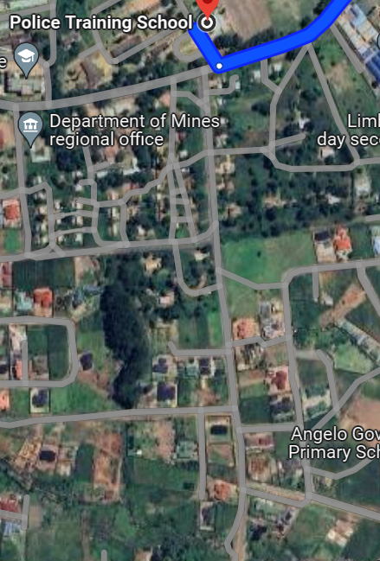
HERE- LAST HOUSE BEFORE THE BRIDGE TO ANGELS GO THERE

